Slide 1

WIPRO NGA Program – Datacenter Batch 5
Capstone Project Presentation – 06 April 2024
Project Title Here – Installation of 2016 server and active directory environment
Presented by – Kishor Chandra sahoo
www.rpsconsulting.in

Slide 2
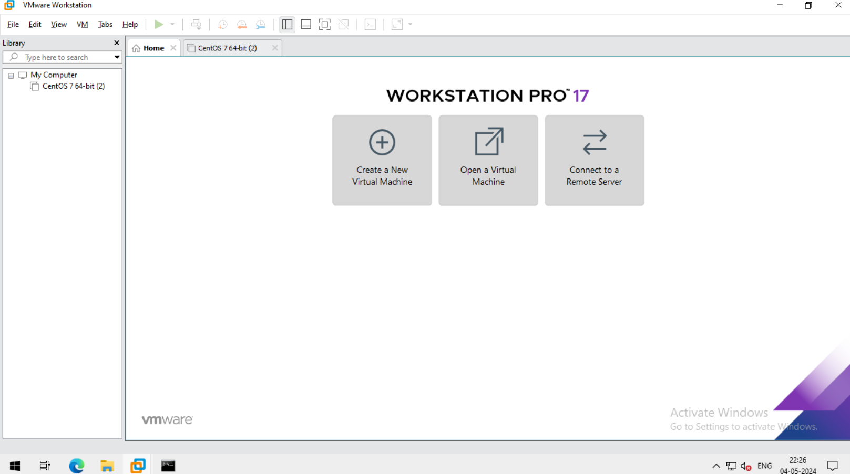
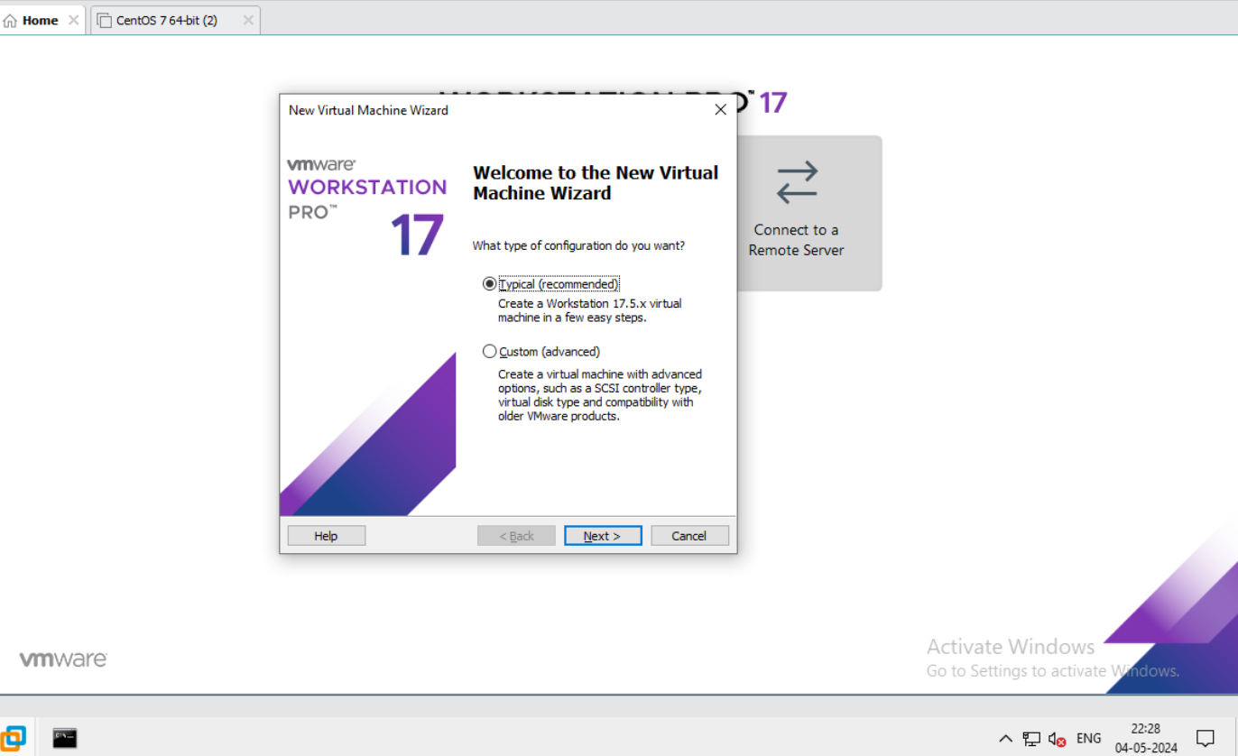

For Installing window 2016 server first we need to open vmware workstation.
Then go to create a new virtual machine.
Then new virtual machine wizard will be open then choose typical

Slide 3
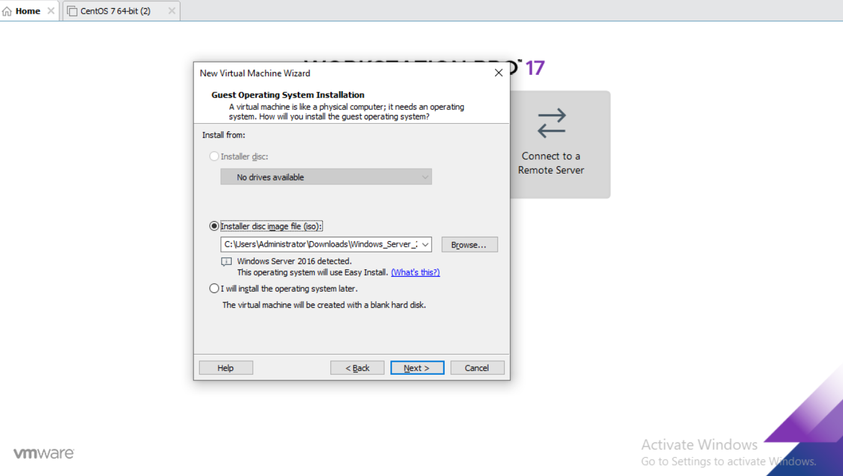
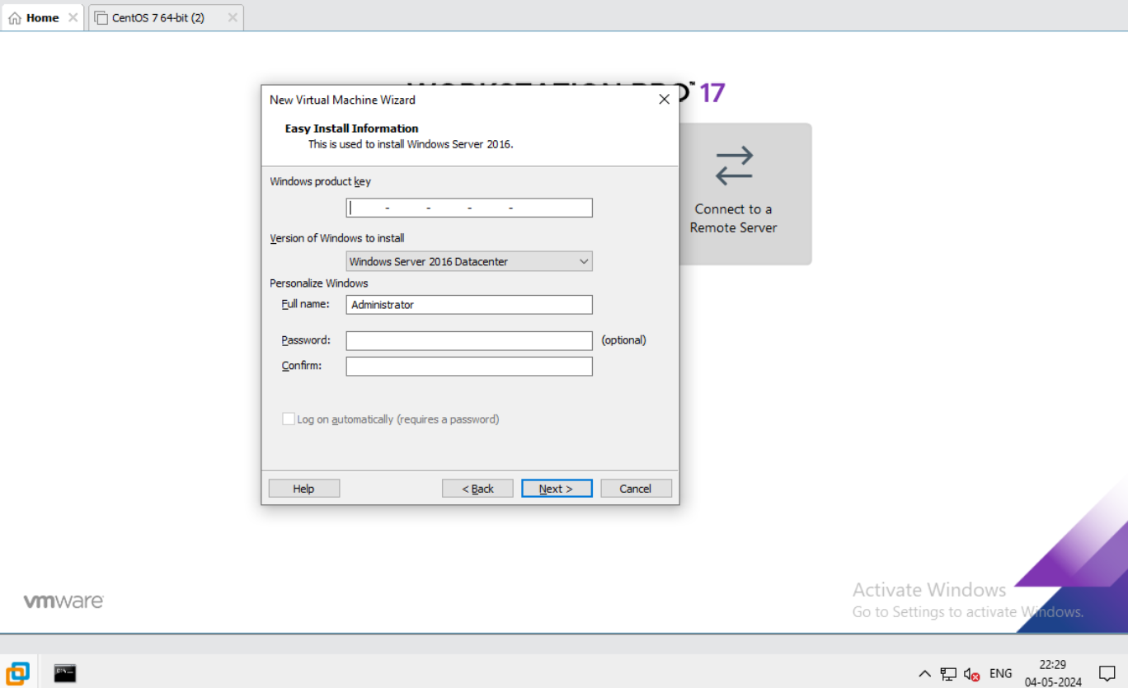
After that browse window server 2016 from downloaded software.
Then click next.
Then click next to move foreward.

Slide 4
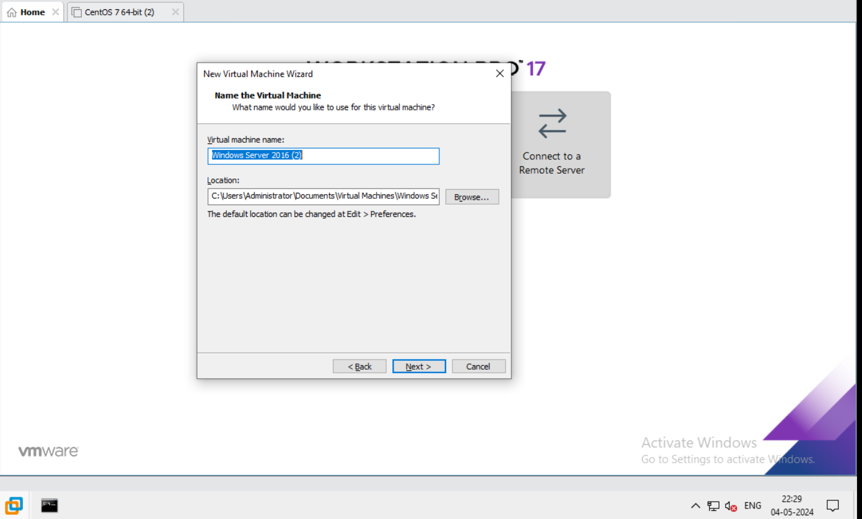
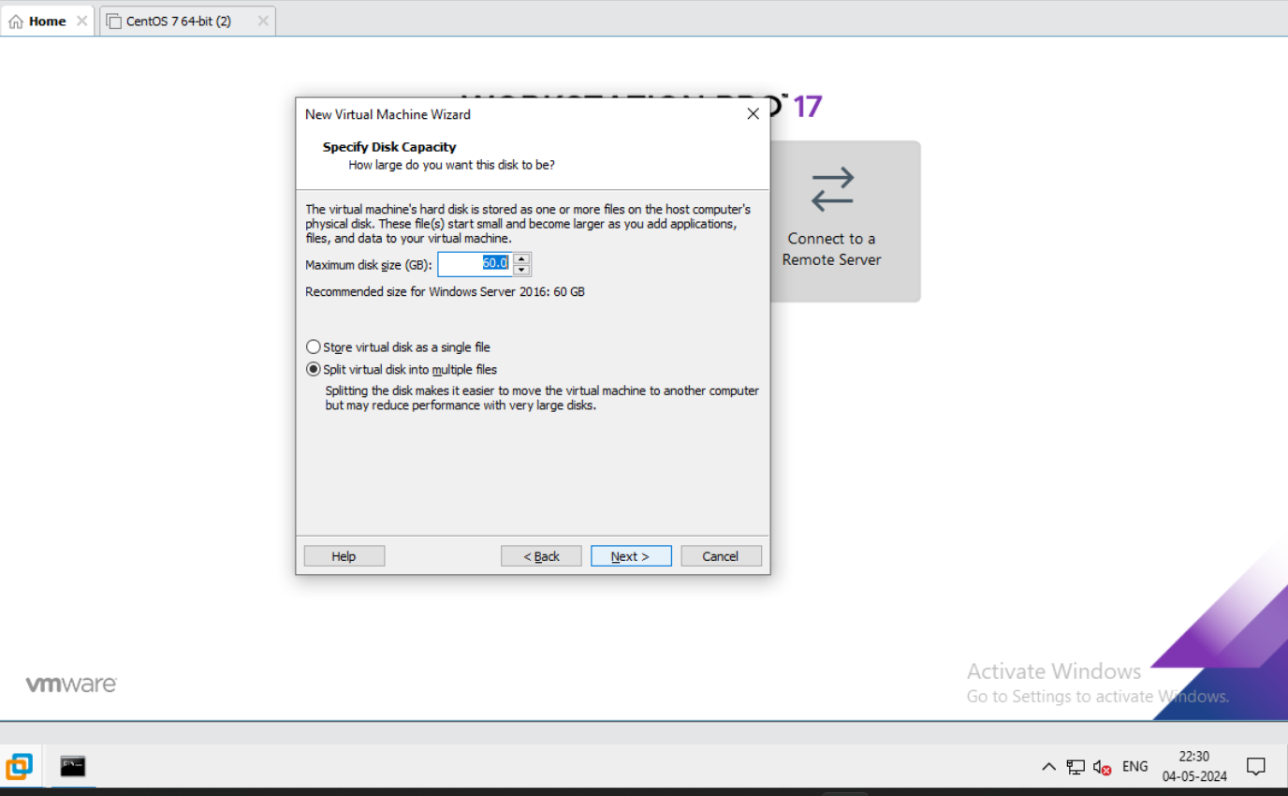
Then give the name to the new virtual machine.
Click next.
Now ,specify the disk capacity by give the value in GB.

Slide 5
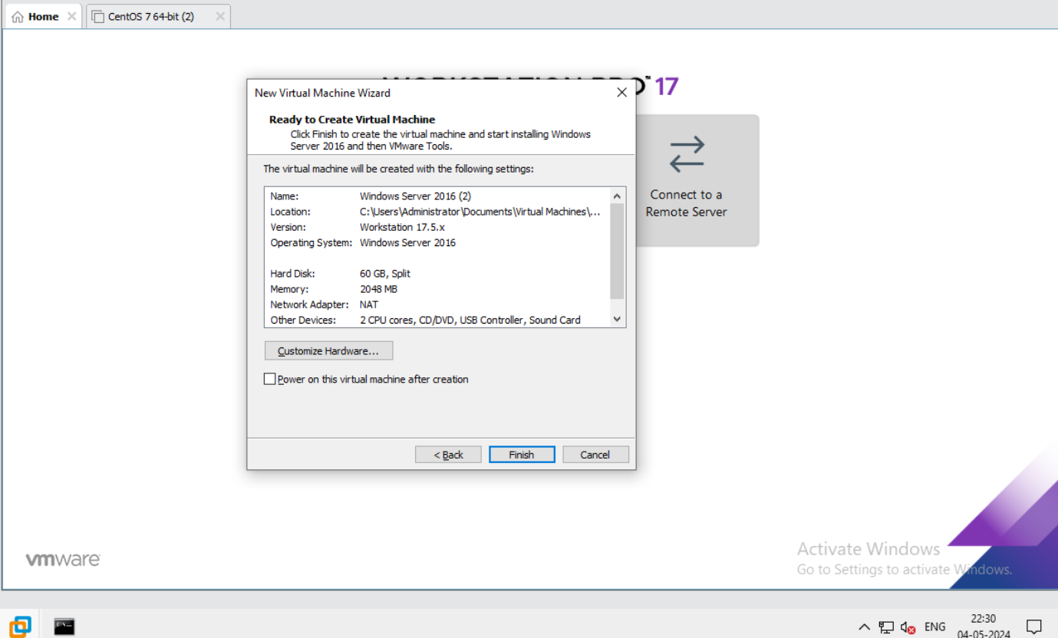
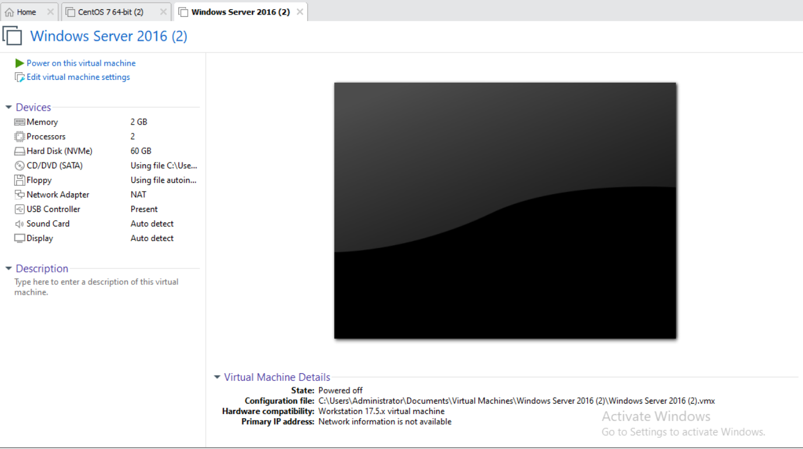
Virtual machine now ready to create.
Click on finish.
This is the first page of our window 2016 server.

Slide 6
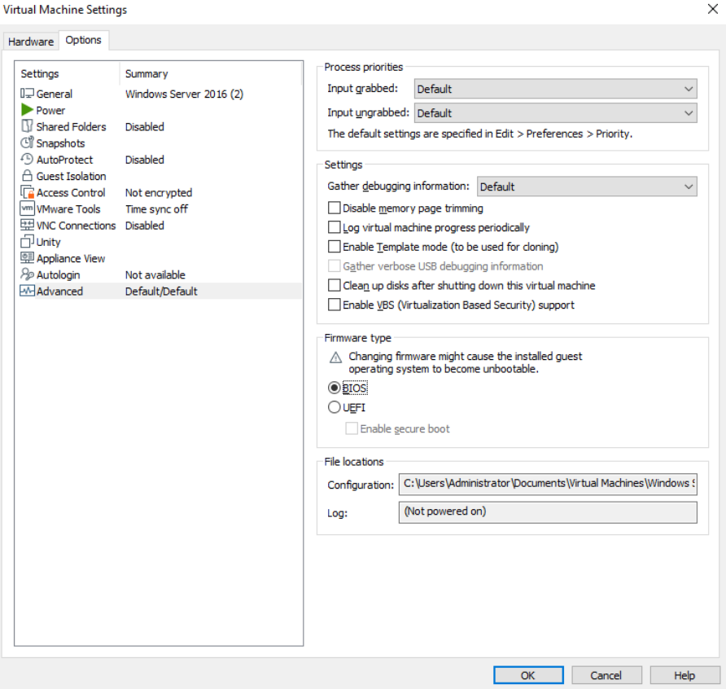
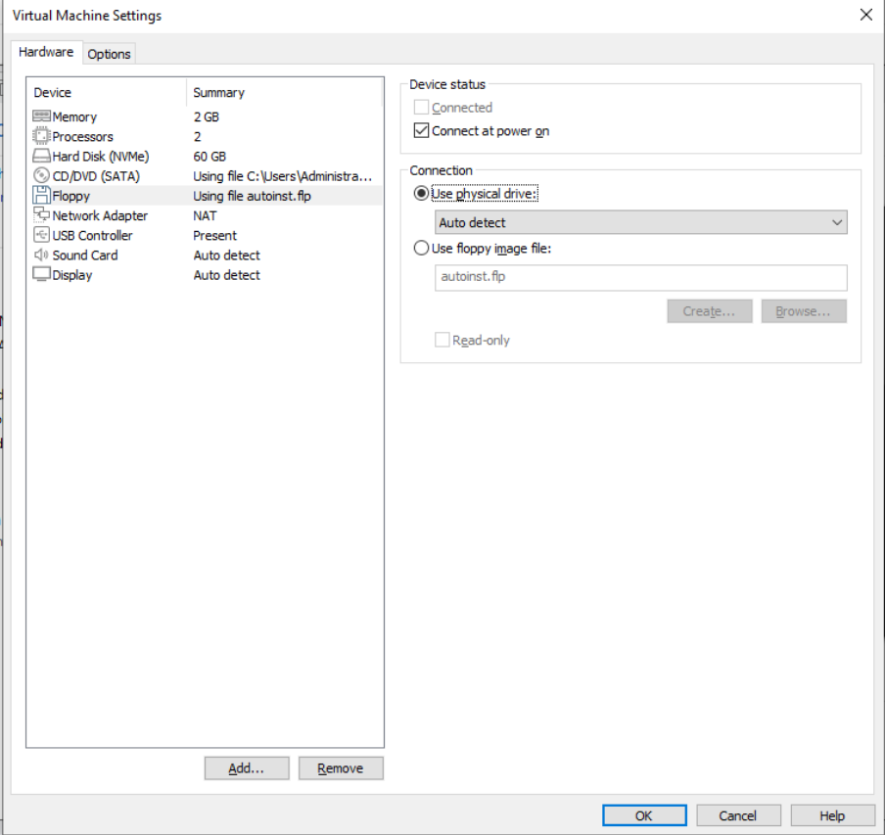
Now edit the virtual machine setting.
Click on option then go to advance
And click on BIOS.
Now click on ok.
Then go to floppy and click on use physical drive.
Then click on ok.

Slide 7
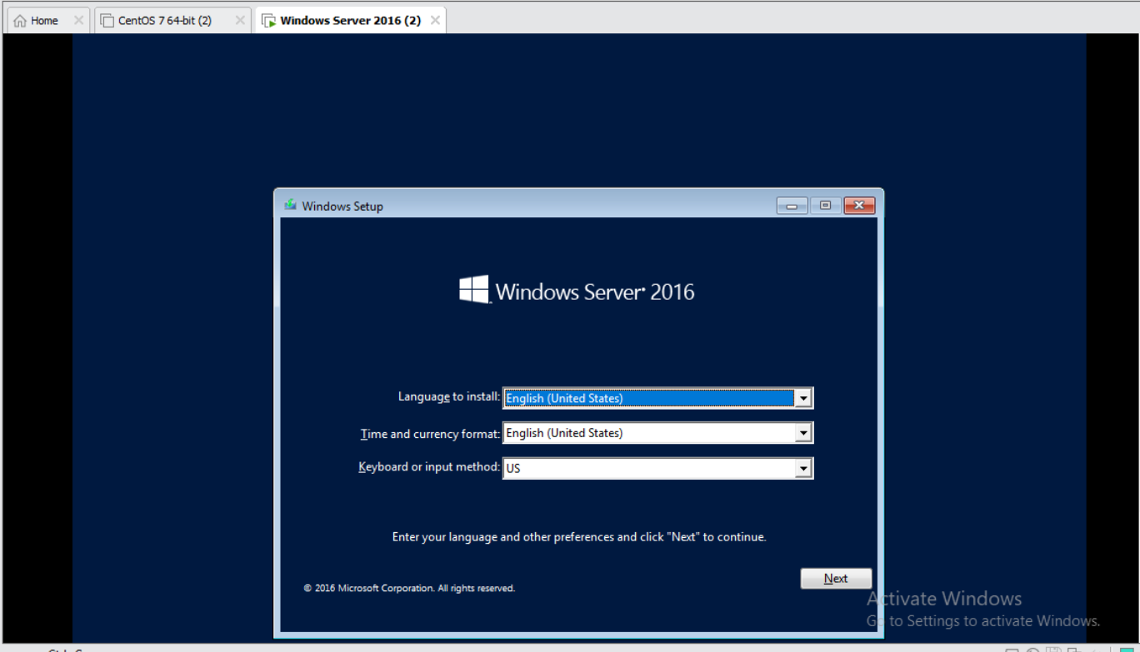
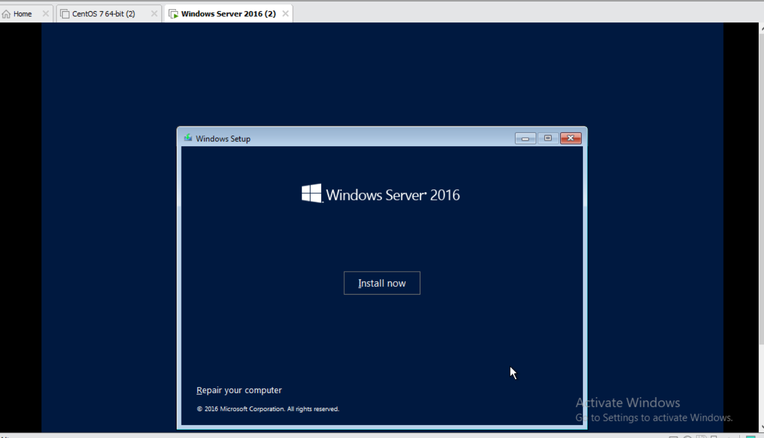
Then open to start the virtual machine.
This is the first interface after starting virtual machine .
Then click on install now.

Slide 8
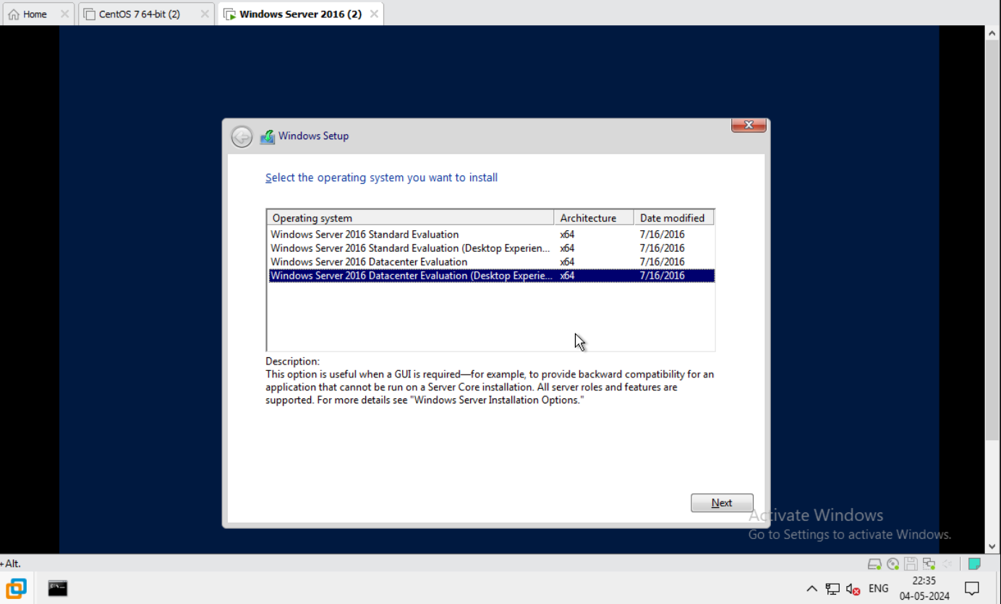
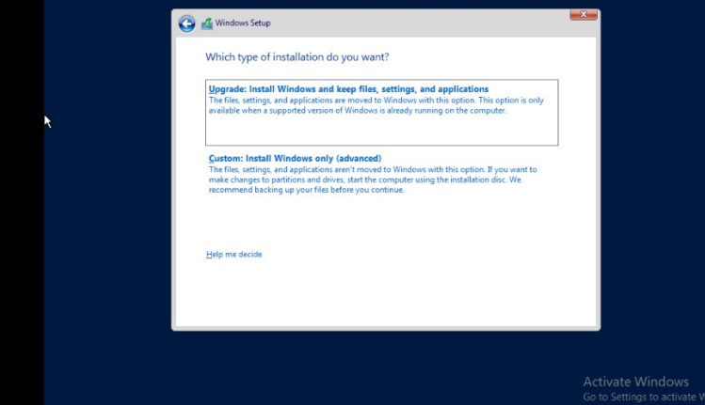
After installation then setup the window and choose 4th one window server 2016 datacenter evolution desktop experience.
Click on next.
For window setup, then click on custom.
Click on next.

Slide 9
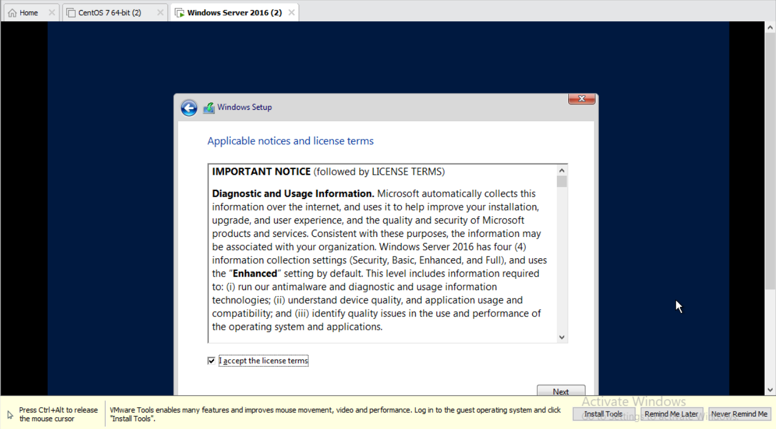
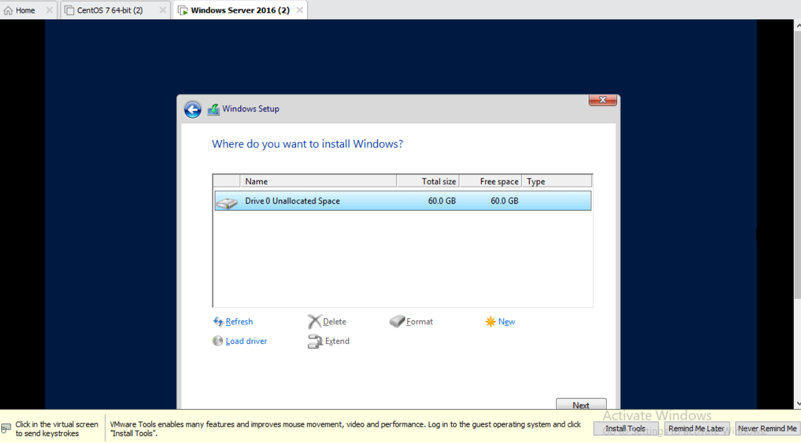
Then accept the permission.
Click on next.
Then no need to any change click on next.

Slide 10
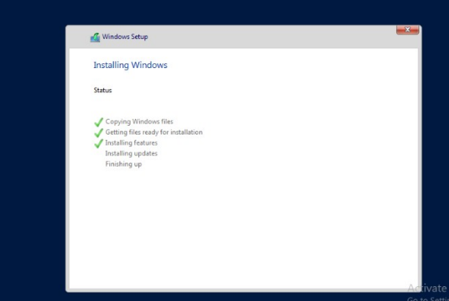
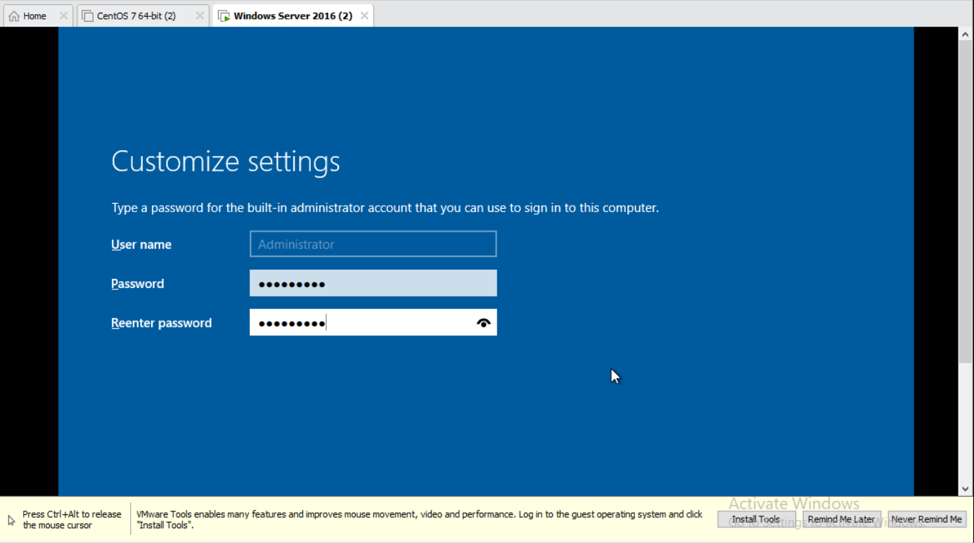
Now our window setup installing automatically.
After installation we move to next step automatically.
Now ,we customize the setting .
Give password and re-type password.
Then click next.

Slide 11
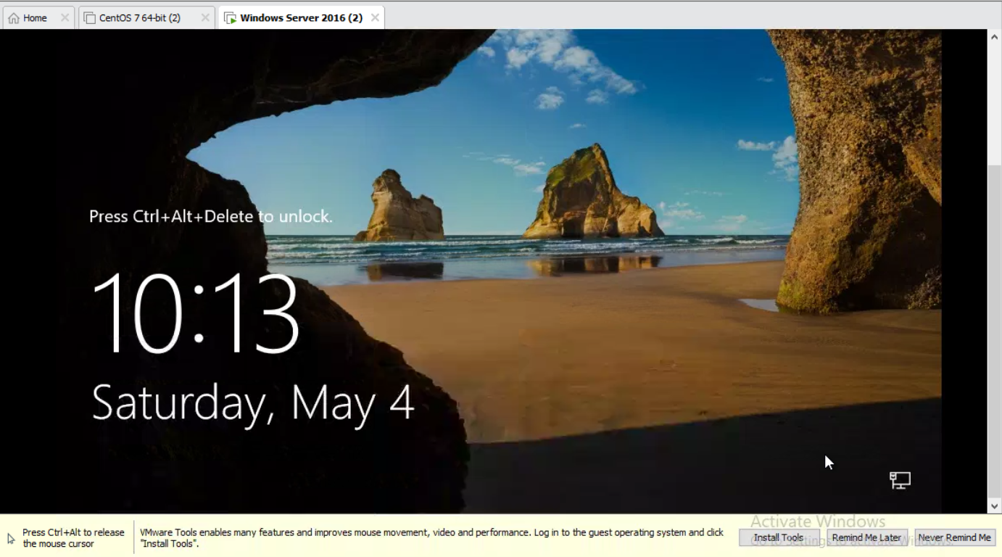
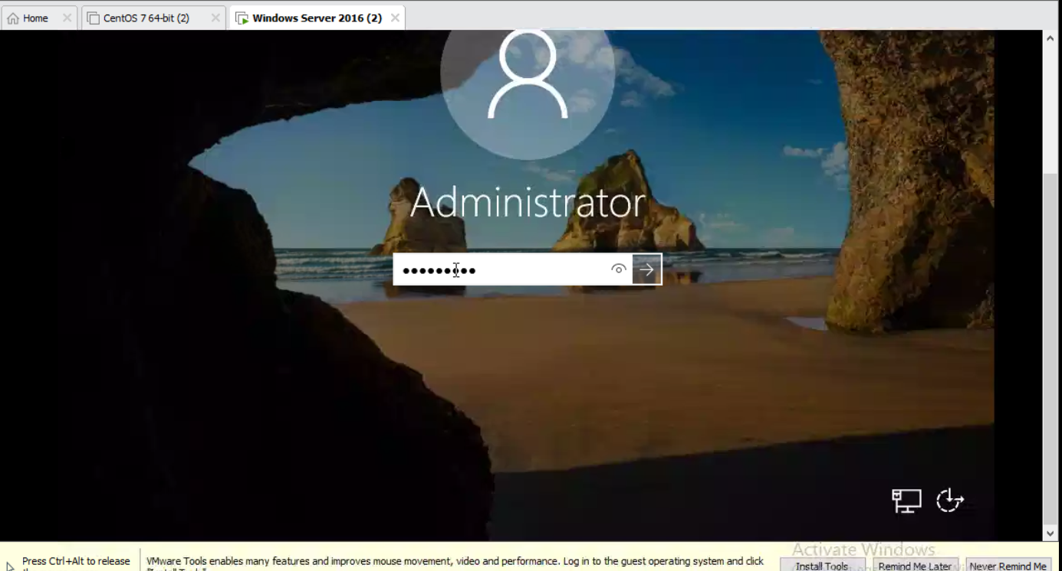
This is our first look after installation.
Now we right click on window server 2016 and then click on cntrl+alt+delete.
Now give password to the administrator.
Then press enter to open.

Slide 12
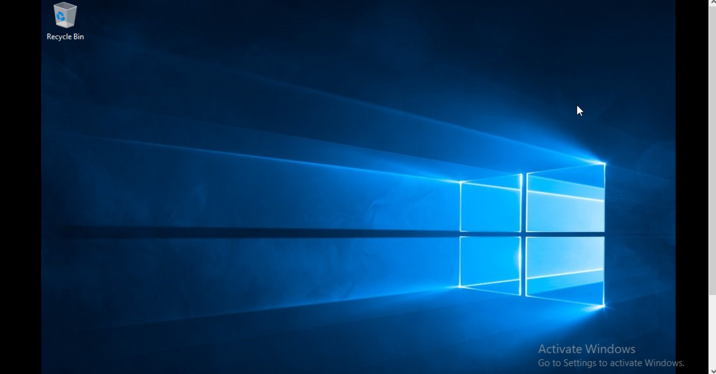
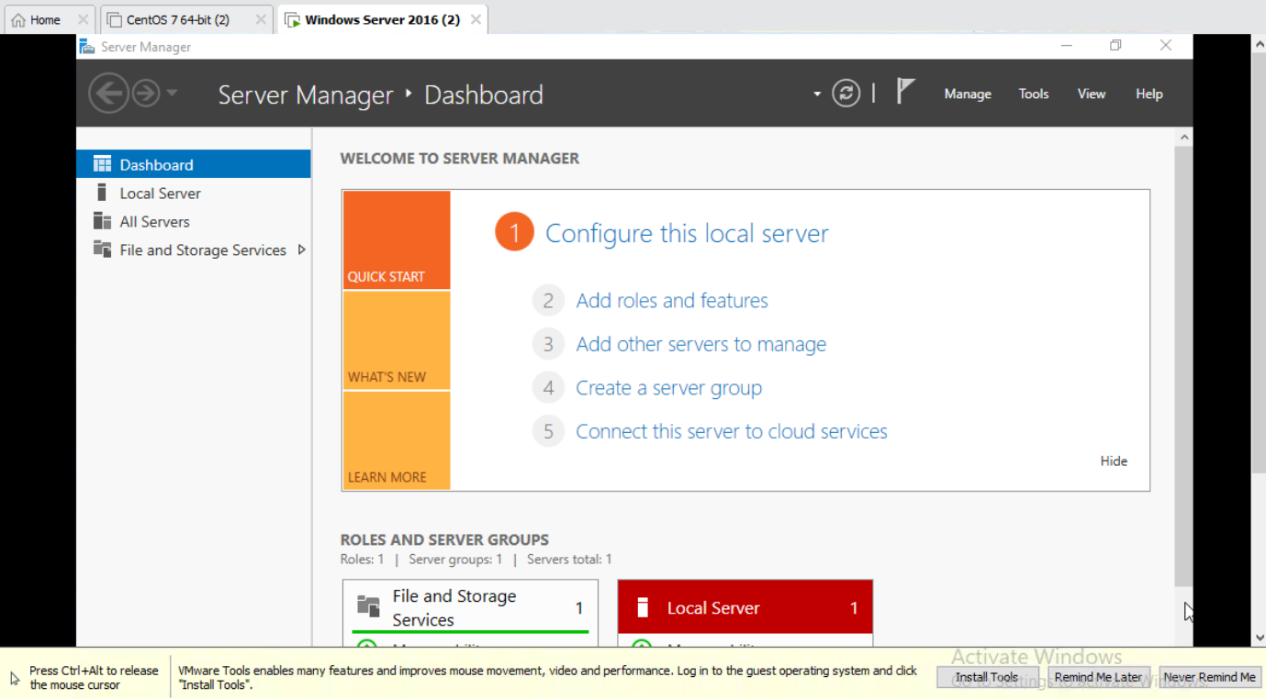
This is our first screen look after installing window 2016 server.
Then open server manager .
This is our first look.

Slide 13
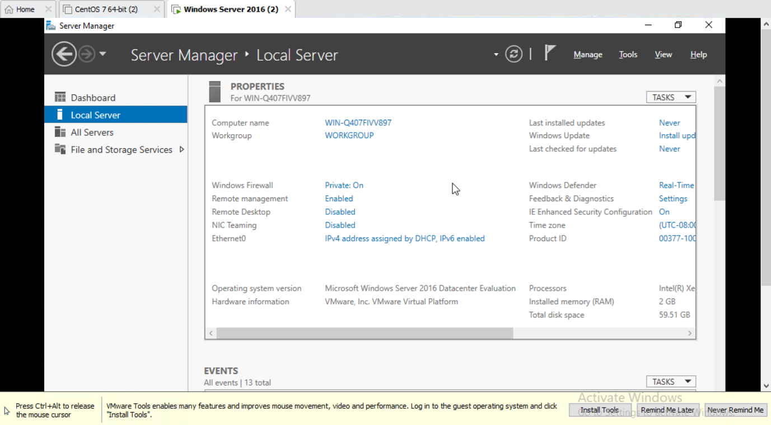
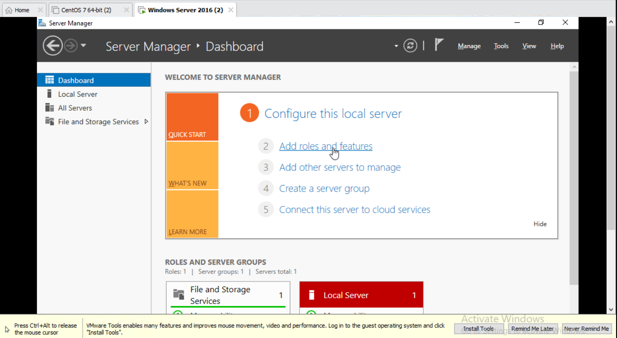
Then click on local server for more information about the server.
Then go to dashboard and click on add role and features.

Slide 14
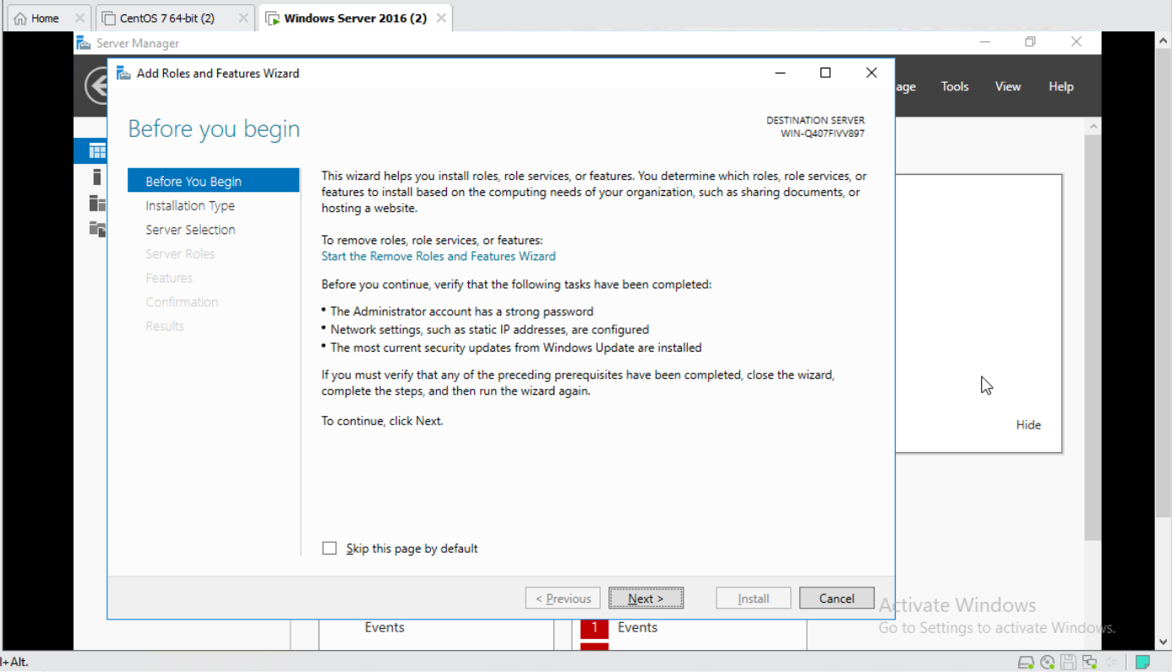
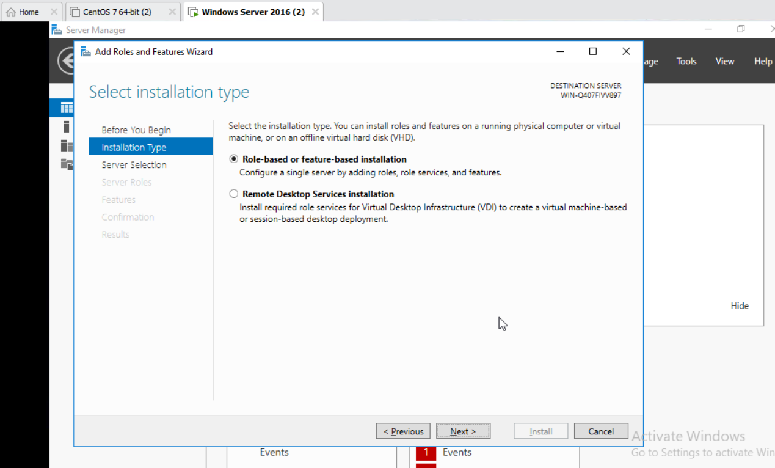
This is the first step of installing ADDS and IIS.
Click on next.
For installation type choose role based installation.
Click on next.

Slide 15
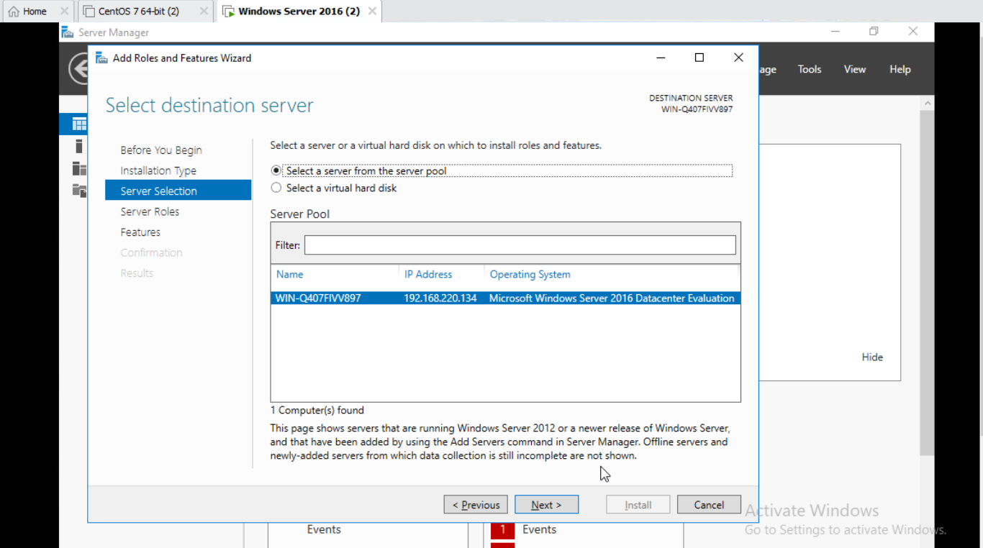
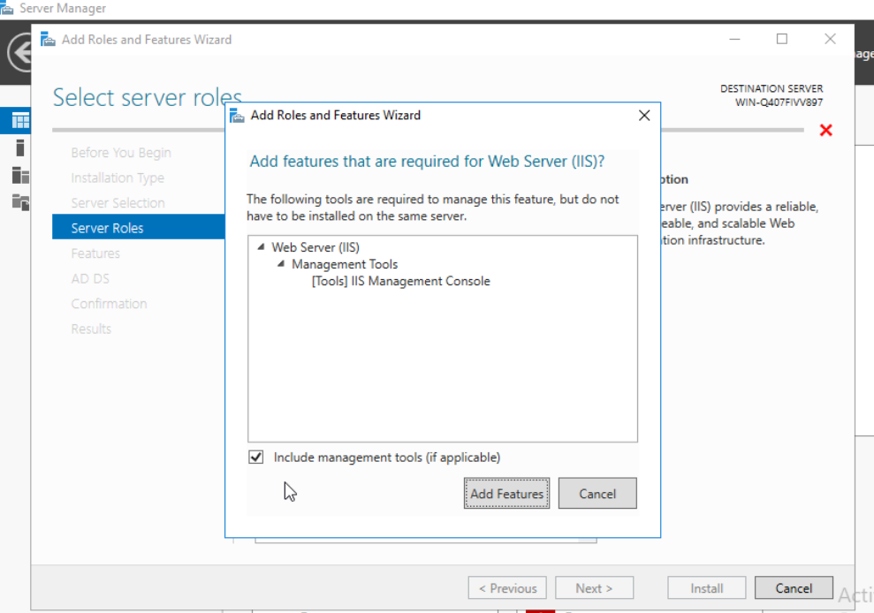
Then select destination server and click on next.
After that click on active directory domain server box ,just check the box.
After that add features.

Slide 16
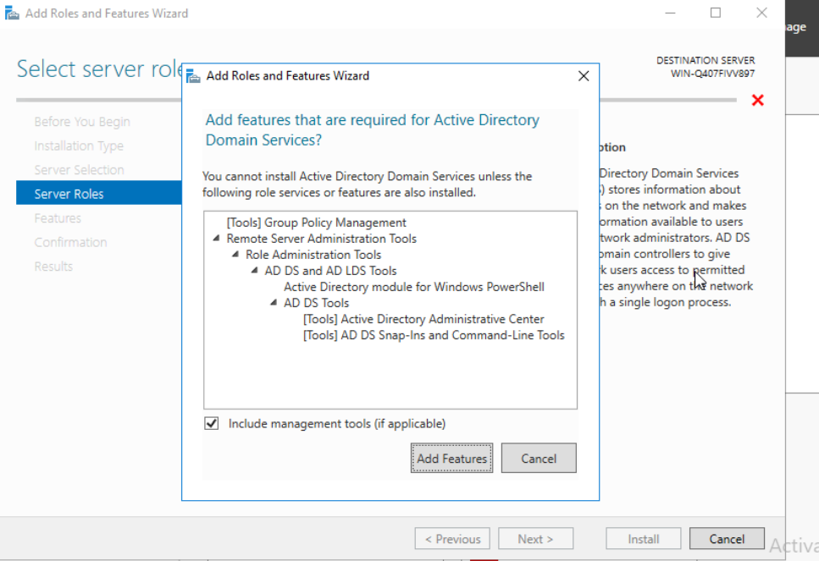
Here only add active directory domain server features and go to next step for installing ADDS& IIS.

Slide 17
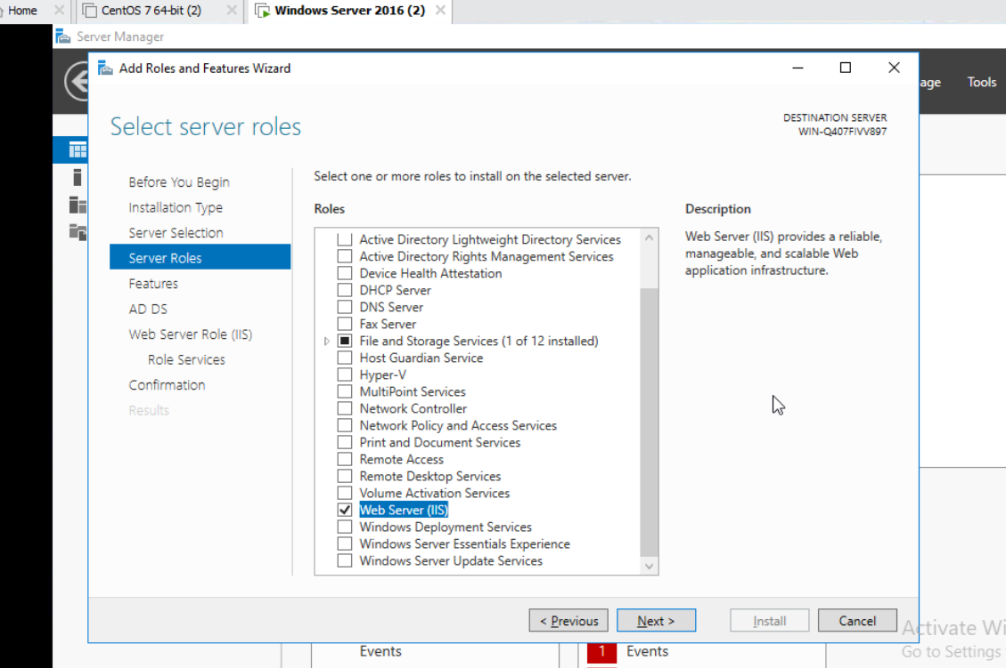
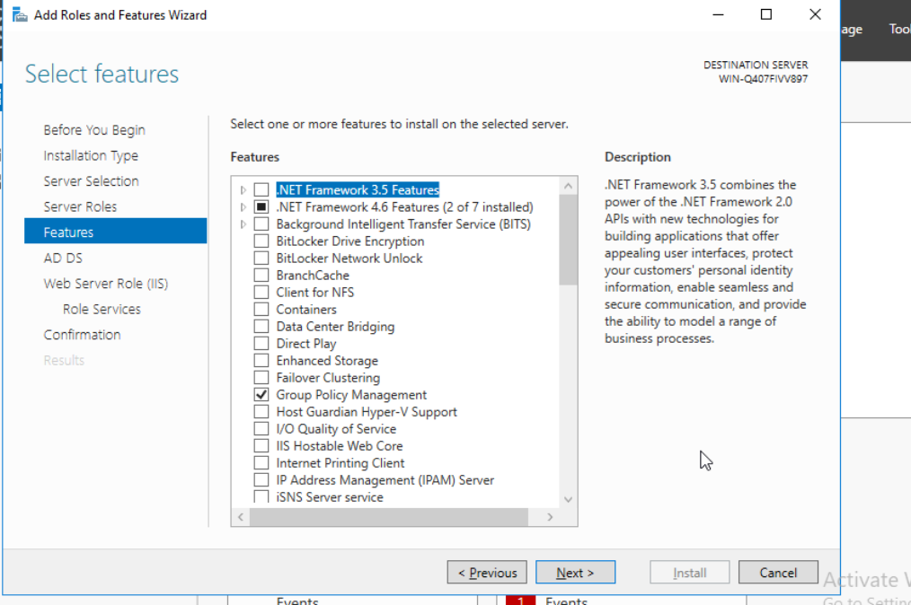
Then check the box web server IIS.
Then check group policy management.
Then click on next.

Slide 18
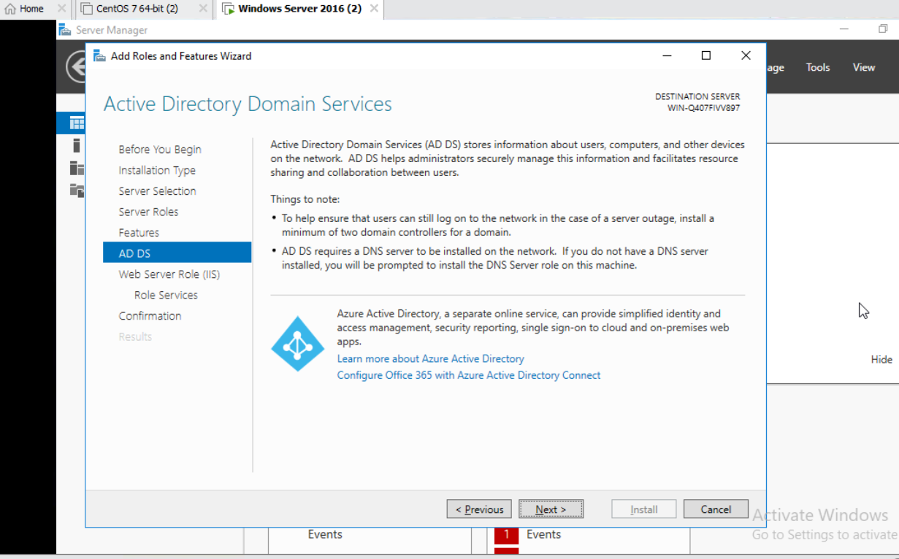
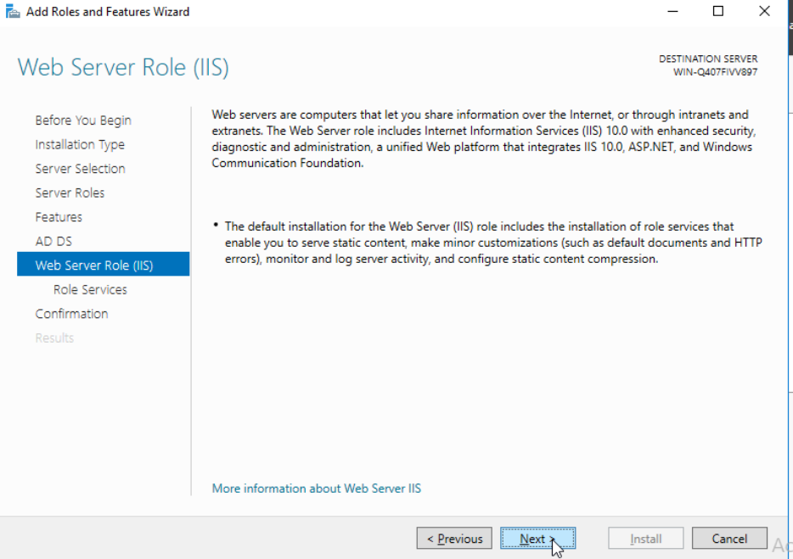
In adds stores information about computer , user and other devices.
Then click on next.
Then move to IIS click on next.

Slide 19
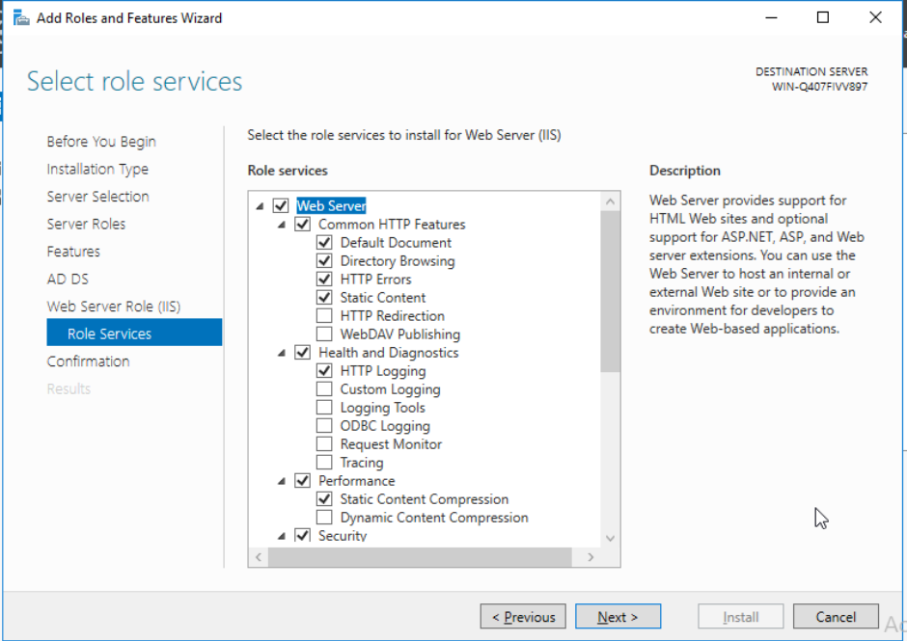
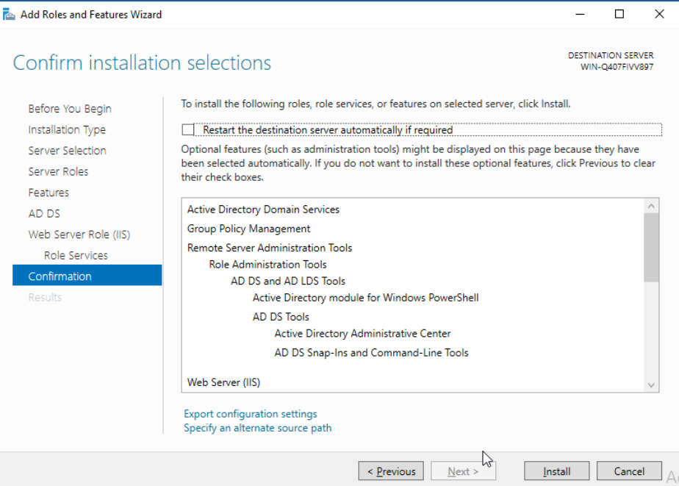
Then select role and service .
And check the required box and check them.
Click on next.
Then confirm installation selection .
Then click on next.

Slide 20
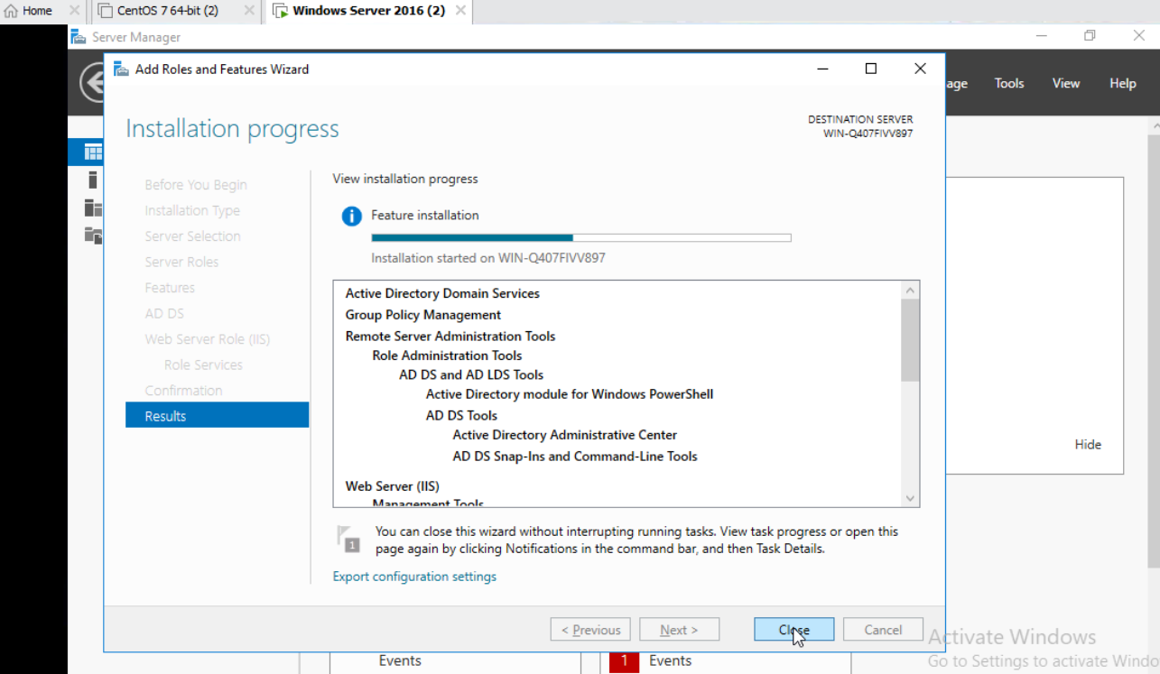
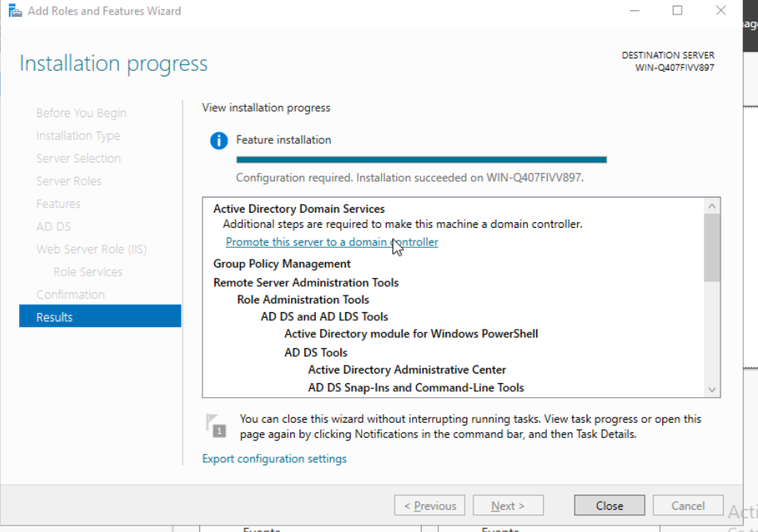
Then Installation process start.
It take time then after installation.
Click on close.

Slide 21
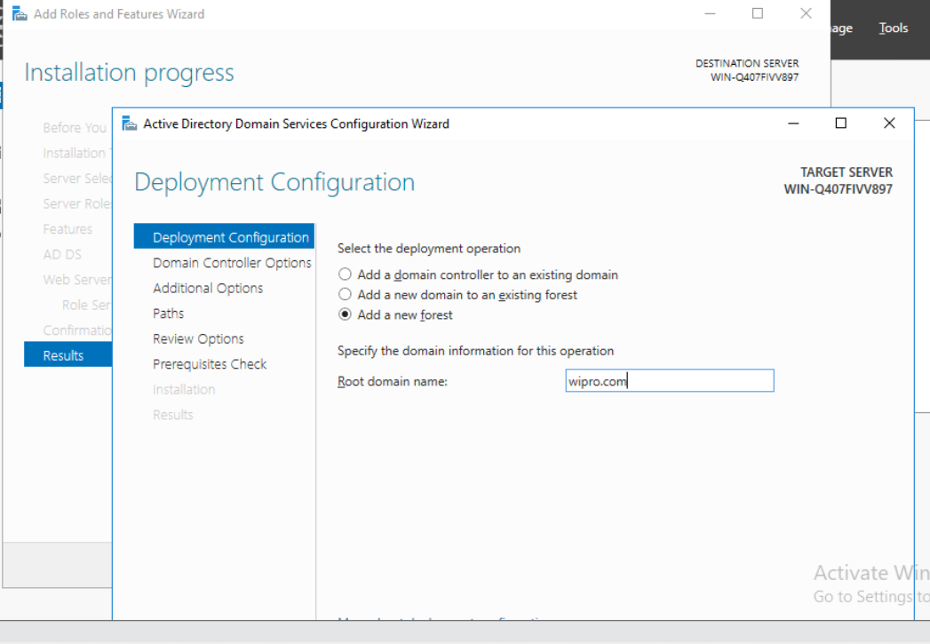
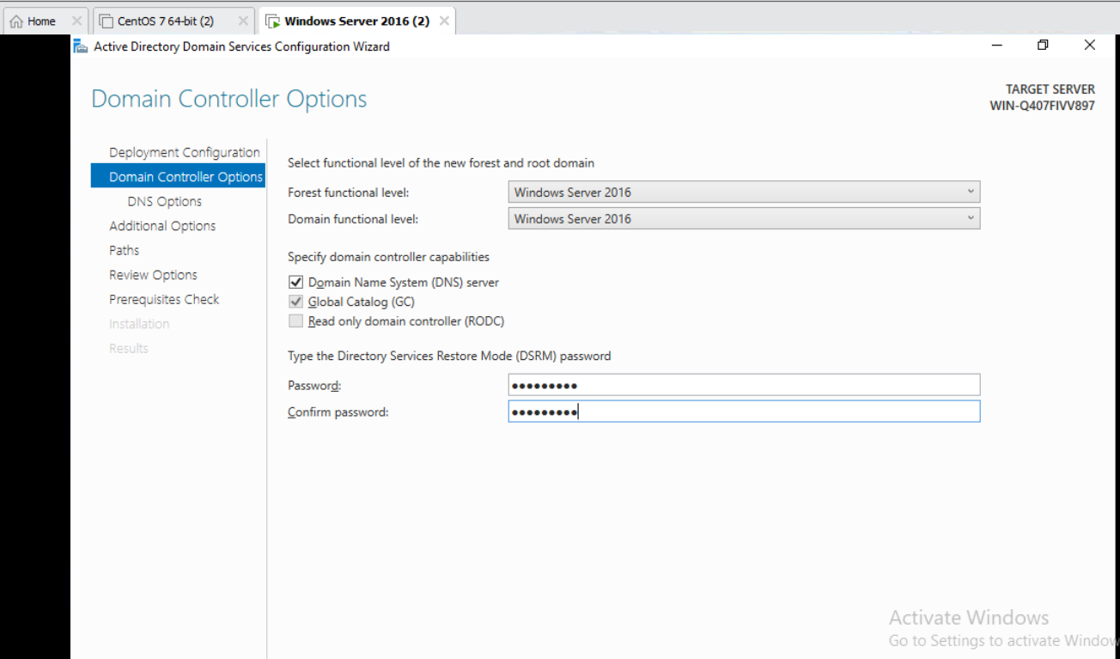
Then deployment configuration and click on add a new forest.
Give the root domain name .
I give wipro.com.
Then click on next.
Then domain controller option give password.
Then click on next.

Slide 22
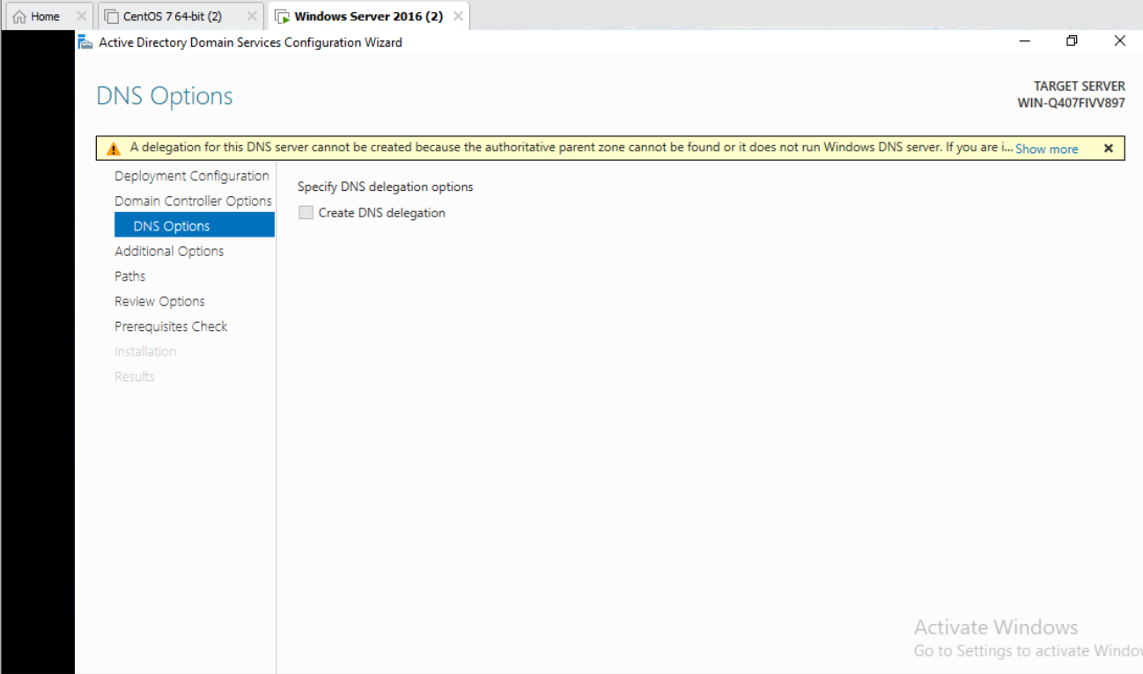
Then DNS options and its take time then click next.
Evert step take little bit of time wait sometime for next step.

Slide 23
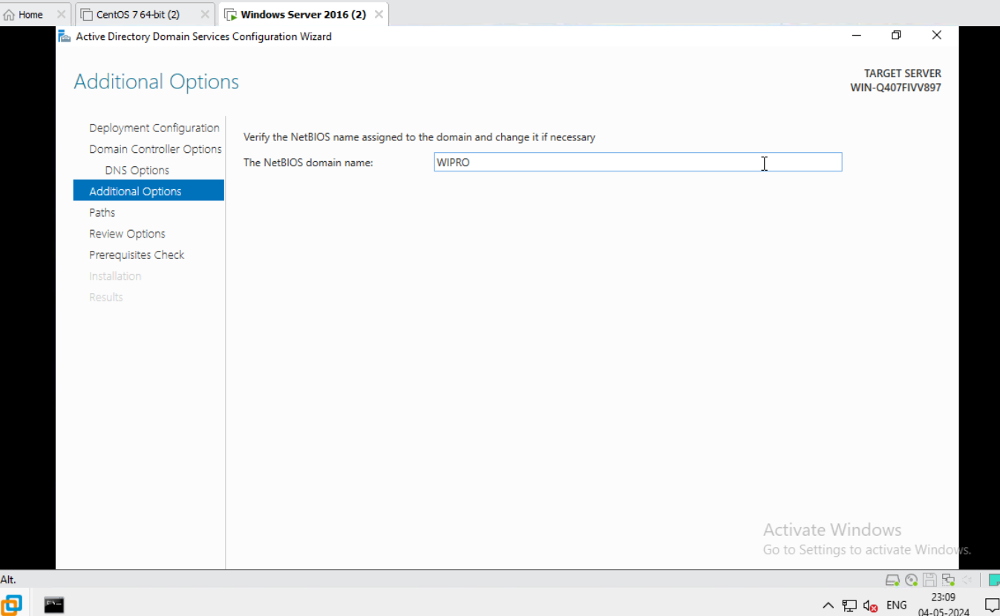
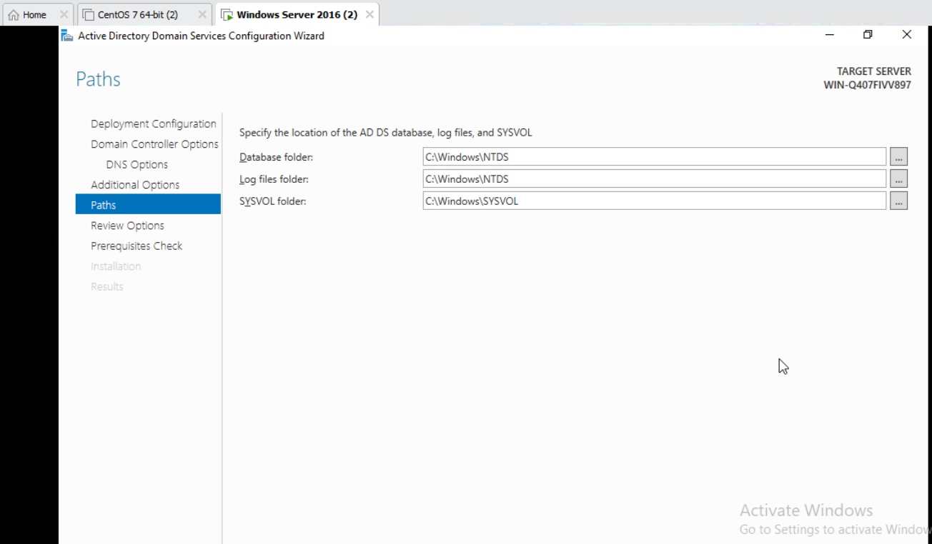
After that verify the NetBIOS name assigned to the domain.
It show automatically.
Then click on next.
Then go to path.
Click on next.

Slide 24
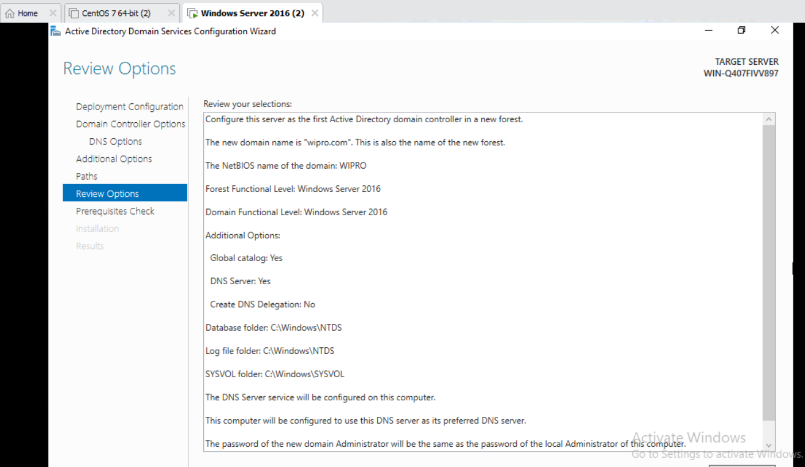
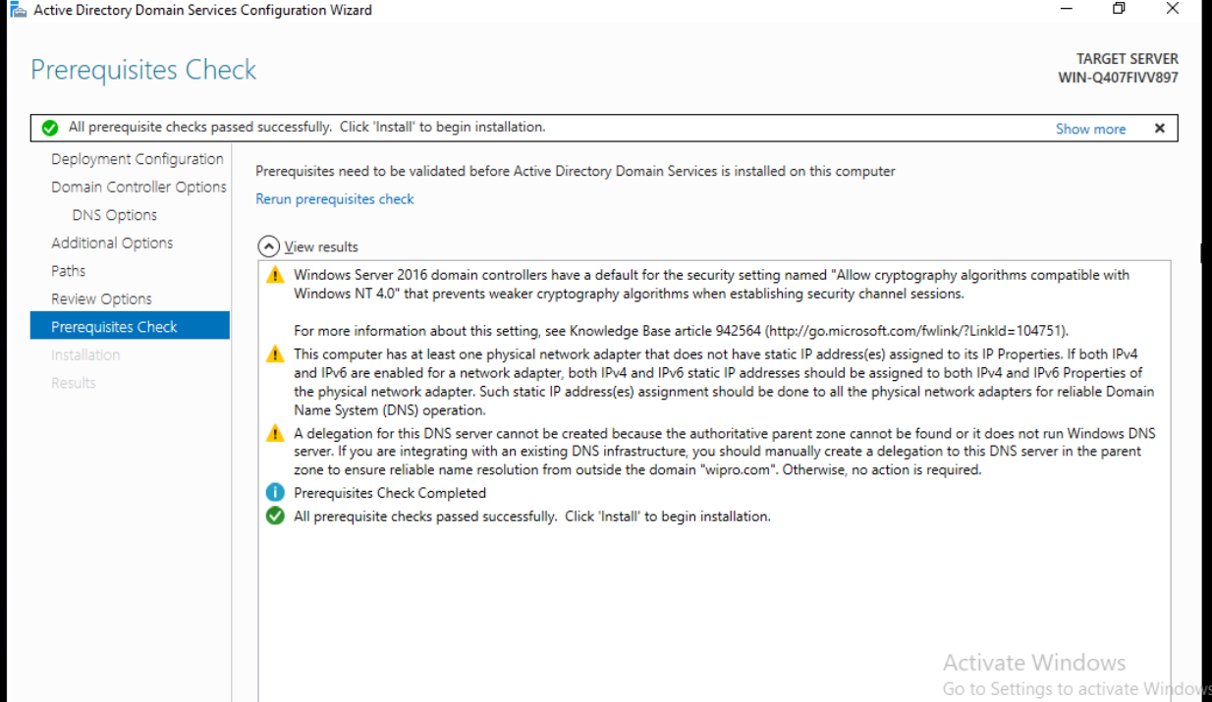
Then review the option.
Take time click on next.
Then prerequisites check.
It run automatically.

Slide 25
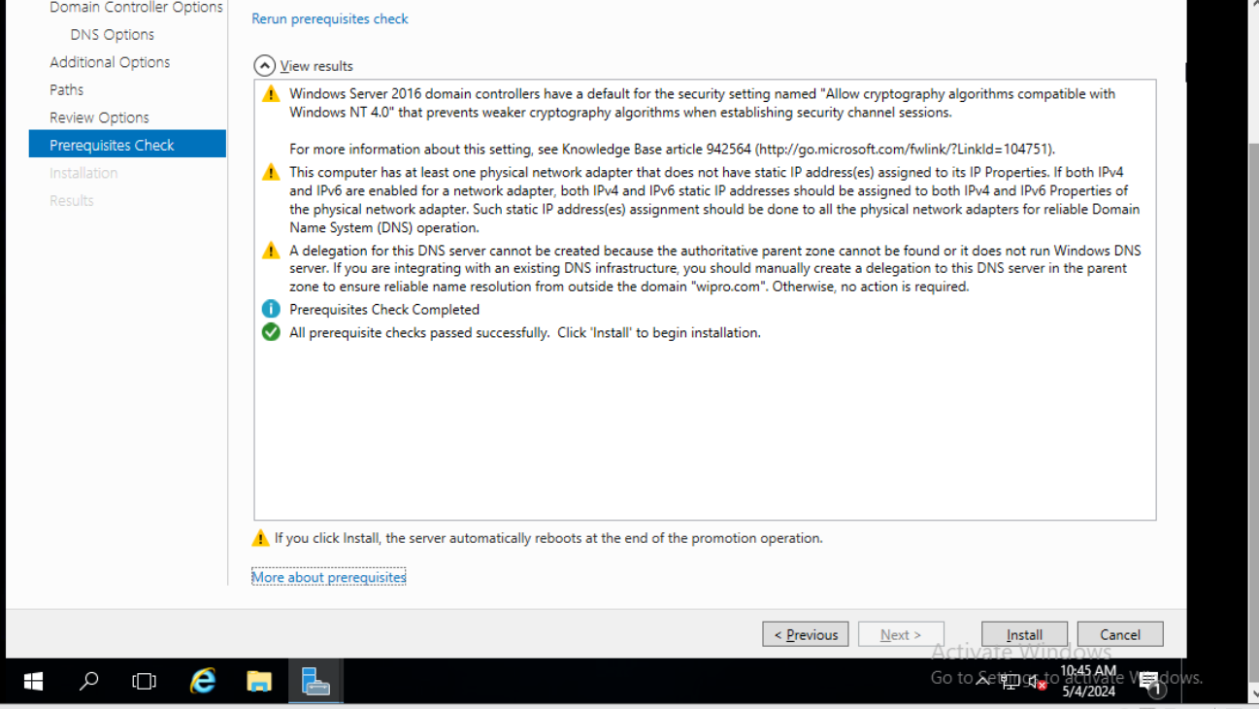
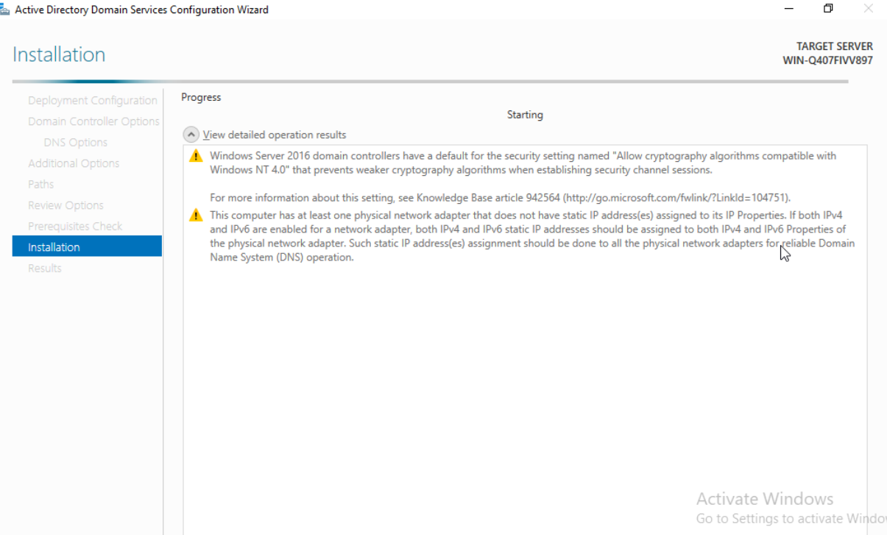
It take time after run system need to restart.
Then click on restart.

Slide 26
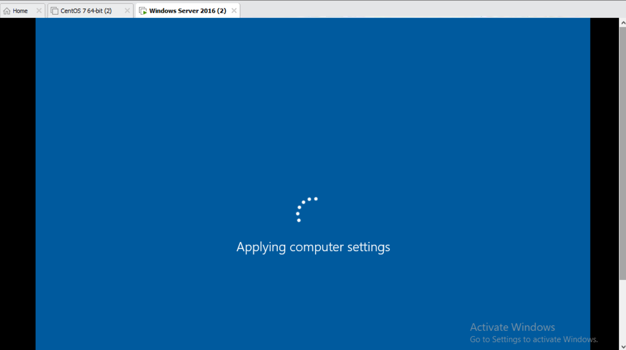
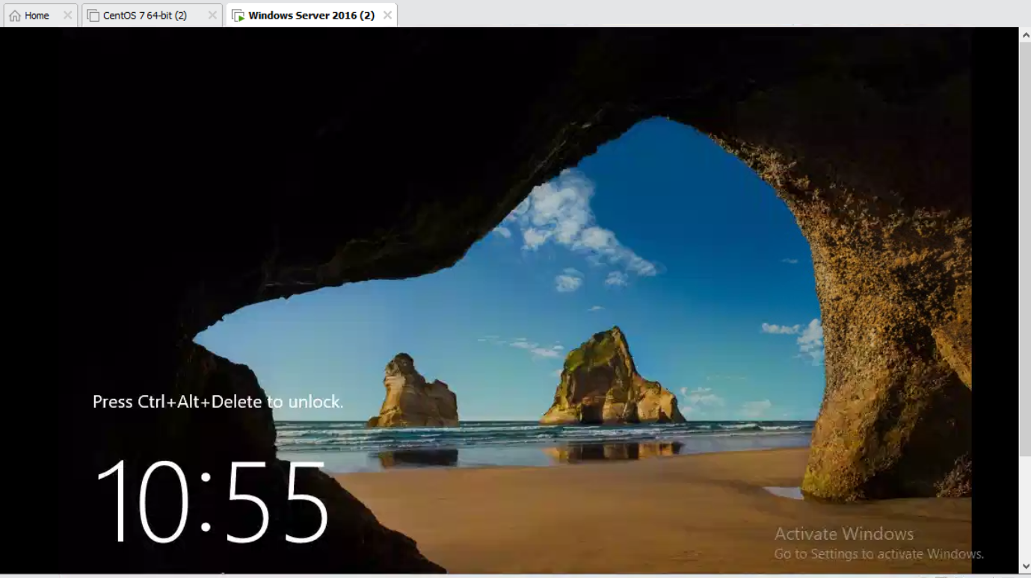
After restart this is the first look of window.
It also take some time.

Slide 27
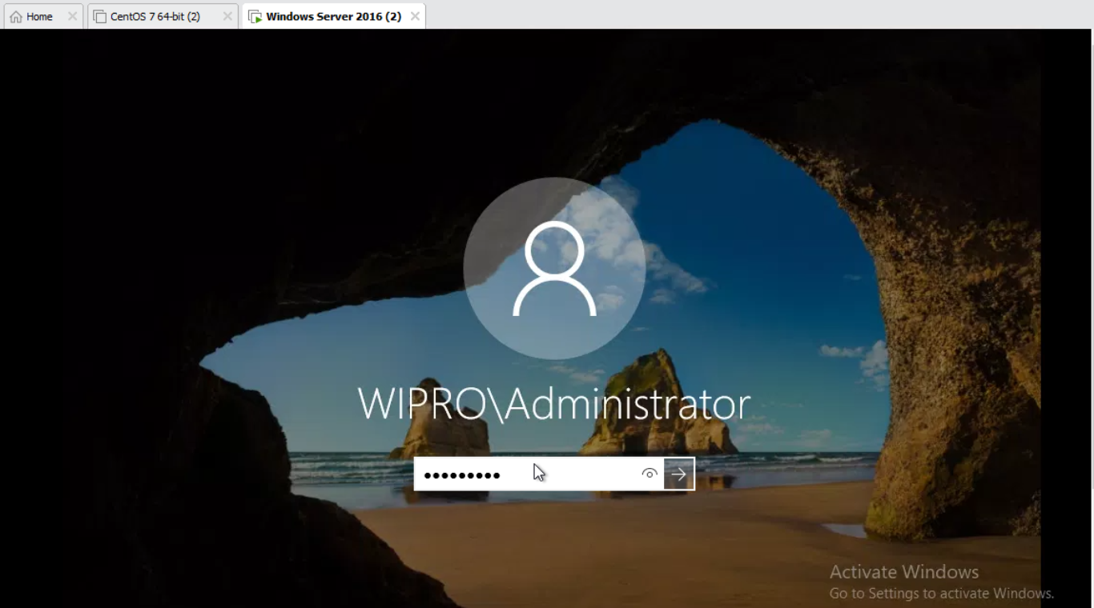
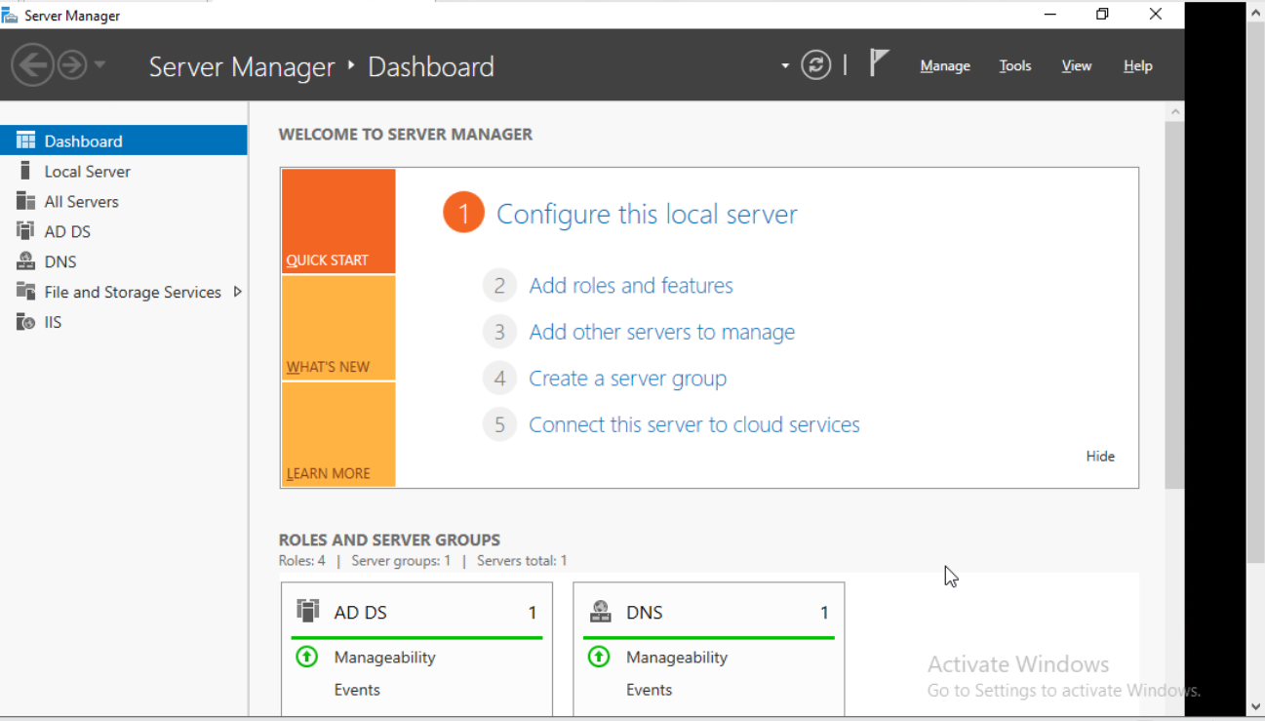
Then give id password to the system and our server manager will be open.
Then see our ADDS,DNS & IIS is install successfully.

Slide 28

For configure basic server hostname then go to system .
Click on change setting.

Slide 29


Then go to system properties and click on change.
After that show a warning message then click on next and move to next.

Slide 30


Then give the computer name as I give Kishor.
Then click ok.
Then see the host name change to Kishor.

Slide 31


For date and time zone go to right side of pc click on date and time.
Then go adjust date and time.
Now see the date and time of computer.

Slide 32


Now see the date and time .
Also check the standard time .

Slide 33


For configure ip address.
Go to network and internet.
Then click on change adaptor option.
Then go to the Eathernet0 .

Slide 34


Then right click on eathernet and go to property.
Go to the ipv4 and change the ip address.
Then assign the ip address.

Slide 35

Now open command prompt and run ipconfig /all to see all the details.
The below screengraph are trouble shoot of active directory domain server.

Slide 36


Two open services.
Then go to active directory domain service properties.

Slide 37


Then go to service local.
Then stop other service.

Slide 38


Then stop other services.
Then go to services control.

Slide 39


Then restart other services click on yes.

Slide 40


Here for firewall configuration , first go to control pannel and open it.
Then click system and security.

Slide 41


Then click on window firewall.
Open it.
Go to the turn window firewall on and off.

Slide 42


Then turn off domain network setting , private network setting & public network setting.
Here is the screen graph after firewall off.

Slide 43
Thank you
Kishor chandra sahoo

